Slide 1

Morse Code Translator
Keerthi (116787)
Ahmed (116786)

Slide 2
What is morse code ?
Morse code is a method used in telecommunication to encode text characters as standardized sequences of two different signal durations, called dots and dashes. Morse code is named after Samuel Morse, one of the inventors of the telegraph.
International Morse Code encodes the 26 basic Latin letters a through z, one accented Latin letter (é), the Arabic numerals, and a small set of punctuation and procedural signals (prosigns). There is no distinction between upper and lower case letters. Each Morse code symbol is formed by a sequence of dots and dashes.

Slide 3
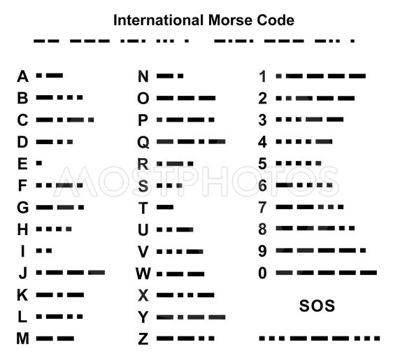
Per defined codes :-

Slide 4
Is Morse Code Still Practical?
Although Morse code is not used as much as the past anymore, it still has its own applications. Morse code is still popular among enthusiasts in the field of amateur radios. Morse code is also used in aeronautical navigation systems. Many ships use Morse code to send light for communication or help. Also, those who can not talk for any reason can also use Morse code to express their meaning.
And besides all, learning and using Morse code to communicate can be fun and entertaining.

Slide 5
Can you guess ?!!
.. / .- -- / .-. . .- -.. -.-- / - --- / .--. .-. . ... . -. –
Its looks complex for some and easy for others to solve it. But can you guess what it it ??
Well the sentence says “I am ready for presentation”…lets make it simple just by using our Arduino for decoding and encoding it.

Slide 6
Morse Code Encoder :-
It may be a little difficult to remember Morse code and convert texts to this code, so let’s make a translator to convert texts to Morse code!
Here we used Arduino UNO to translate a text to Morse code. Upload this code on your Arduino board and open your serial monitor window. Type your desired word or text and receive it in Morse code, then you can send it as light and sound.

Slide 7
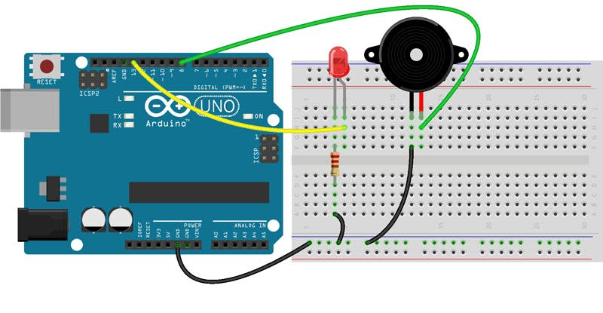
Circuit :-

Slide 8
Morse Code Decoder :-
In another case, you are a Morse Code Recipient and you must convert the received code to text.
To simulate this, send the Morse code to Arduino using the key and see the result as text in the Serial Monitor.

Slide 9
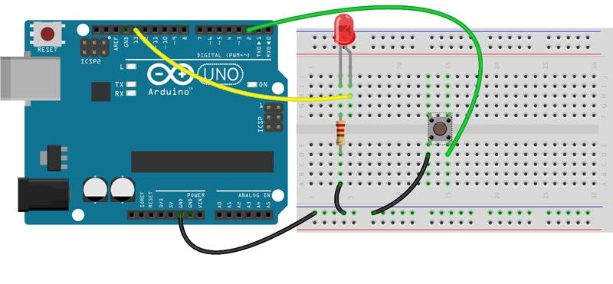
Circuit :-

Slide 10

Let’s do it Live!!

